Slide 1
English Stylistics An Introductory Course
ZHU Ye
SIS, ZJU
2020 Fall-Winter

Slide 2
In today’s lesson
Our understandings of “Style”
Why different styles?
In-class reading (3 texts)
Course information

Slide 3
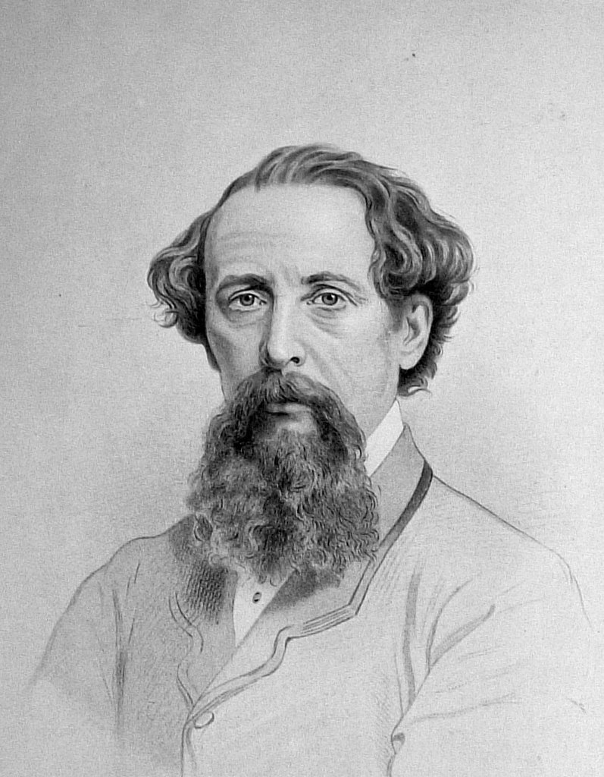

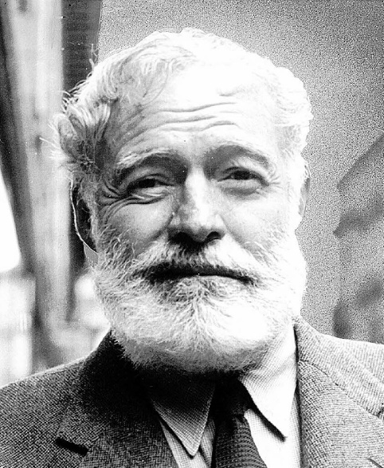
Styles

Slide 4
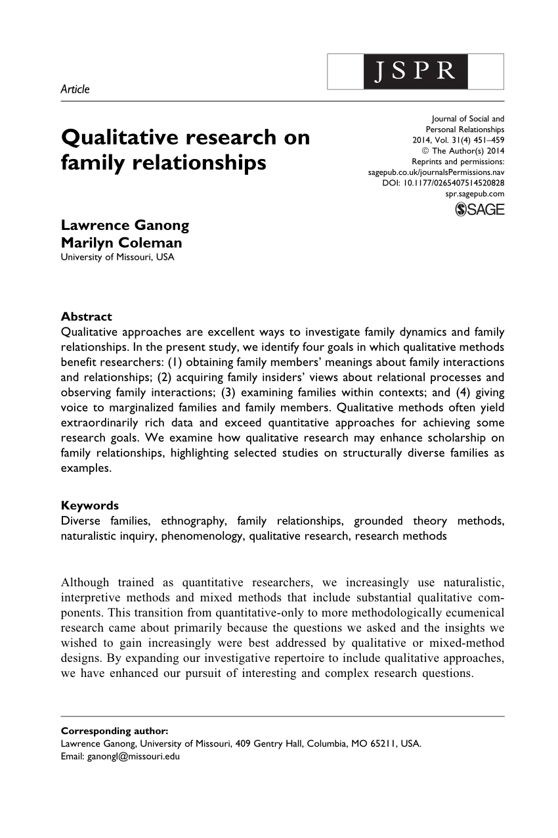


Also styles …

Slide 5




And styles …

Slide 6
Different understandings of “Style”
Style as rhetoric and eloquence
Style as technique of exposition
Style as personal idiosyncrasy
Style as the choice between alternative expressions
…

Slide 7
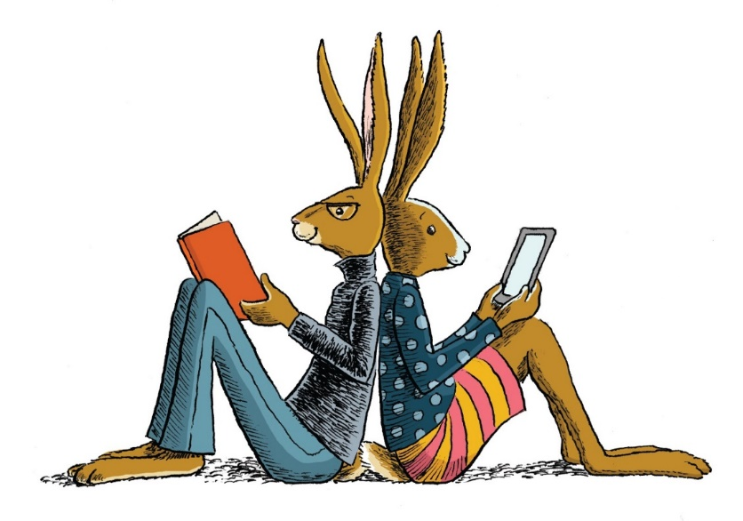
In-class Reading
Which text attracts you most?
Describe your impression about these texts.
Use specific examples in the texts to justify your opinion.

Slide 8
Text 1
Non-fiction, realistic, intense, precise and detailed, engaging
Into Thin Air: A Personal Account of the Mt. Everest Disaster, by Jon Krakauer (1997)

Slide 9



Slide 10
Text 2
Nonfiction, scientific, academic, determined, compassionate
Silence Spring by Rachel Carson (1962) – one of the most-influential books in the modern environmental movement.

Slide 11


Slide 12
Text 3
Literary, imaginative, decorative, descriptive, vivid
Lord of the Rings by J. R. R. Tolkien (1954-1955)

Slide 13

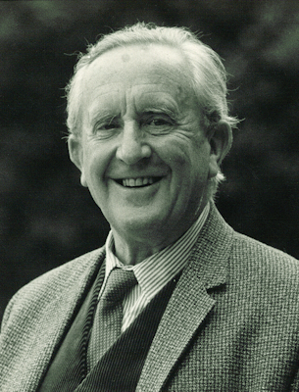

Slide 14
How do we perceive the style?
Words: nouns, verbs, adjectives, jargons, terms, etc.
Sentences: long, short, active, passive, various structures
Rhetorical figures: parallelism, simile, metaphor
Meaning: real-world concepts, imaginations, numbers, etc.
Discourse: first-person, third-person, narration, description, argumentation, etc.

Slide 15
“Stylistics” in Webster New World College Dictionary
The study of style as a means of analyzing works of literature and their effect, now often using mathematical and statistical methods.

Slide 16
“Stylistics” in Oxford English Dictionary
The study of the distinctive styles found in particular literary genres and in the works of individual writers.

Slide 17
“Stylistics” in Collins English Dictionary
A branch of linguistics concerned with the study of characteristic choices in use of language, esp. literary language, as regards sound, form, or vocabulary, made by different individuals or social groups in different situations of use.

Slide 18
“Stylistics” in Wikipedia
Styling, a branch of applied linguistics, is the study and interpretation of texts in regard to their linguistic and tonal style. As a discipline, it links literary criticism to linguistics.

Slide 19
Why different styles?
Different ages/literary schools/writers
Different themes/topics/ genres (体裁)
Different functions/purposes/effects
Different readers/ contexts
…

Slide 20
Style and stylistics
Reading (experience)
→ Impression (intuition and experience)
→→ Observation (Description)
→→→ Interpretation (Evaluation)

Slide 21
Reference books
《实用英语文体学》钱媛，外语教学与研究出版社，2006
《英语文体学教程》张德禄 张国，高等教育出版社，2008
Stylistics: A resource book for students, by Paul Simpson, Routledge, 2004
In-class reading materials

Slide 22

Course performance evaluation
Class performance 10%
Assignments 20%
Quiz 30%
Final paper 40%

Slide 23

Any questions?

Slide 24
Assignment
Close-up reading of the three texts
Search for more information about Style and Stylistics

